Slide 1
Lead Score Case Study
BY KRITHIKA CHANDRASEKARAN

Slide 2
Problem Statement:
An education company named X Education sells online courses to industry professionals
The company markets its courses on several websites and search engines like Google. Once these people land on the website, they might browse the courses or fill up a form for the course or watch some videos. When these people fill up a form providing their email address or phone number, they are classified to be a lead. Moreover, the company also gets leads through past referrals. Once these leads are acquired, employees from the sales team start making calls, writing emails, etc. Through this process, some of the leads get converted while most do not. The typical lead conversion rate at X education is around 30%.
There are a lot of leads generated in the initial stage, but only a few of them come out as paying customers. In the middle stage, you need to nurture the potential leads well (i.e. educating the leads about the product, constantly communicating etc. ) in order to get a higher lead conversion.

Slide 3
Solution Methodology
Understand the Problem Statement
Data Collection
Data Preprocessing
Data Cleaning
Data Transformation
Feature Engineering
Exploratory Data Analysis (EDA)
Model Selection
Model Evaluation

Slide 4
Data Processing
Dataset contain 37 column and 9240 rows include all NaN
Converted the categorical field NaN as 'select’
Observed and dropped the column has more than 45 % of NaN
Dropped the column has Imbalanced data such as ('Through Recommendations', 'Receive More Updates About Our Courses’, etc).
Removed “Prospect ID” and “Lead Number” for analysis

Slide 5
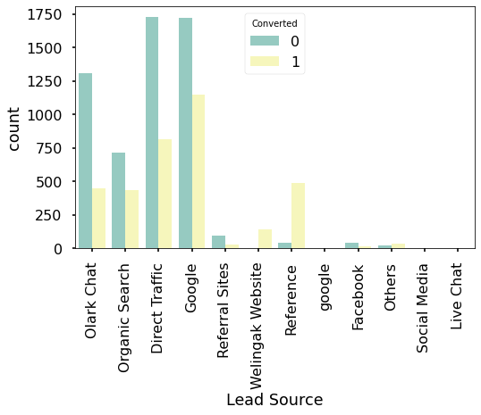
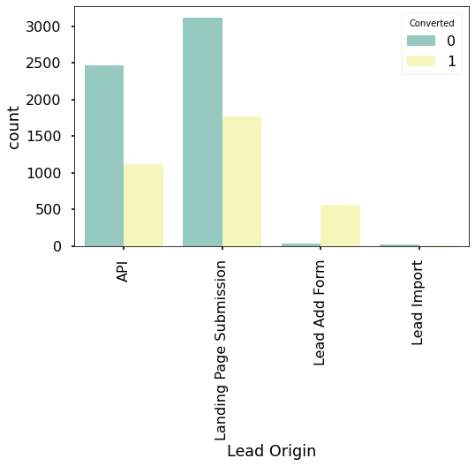
Exploratory Data Analysis (EDA)
Max number of lead from Google link and followed by Direct traffic
Most conversion of leads from the welingak website
API and Landing Page Submission bring higher number of leads as well as conversion.

Slide 6
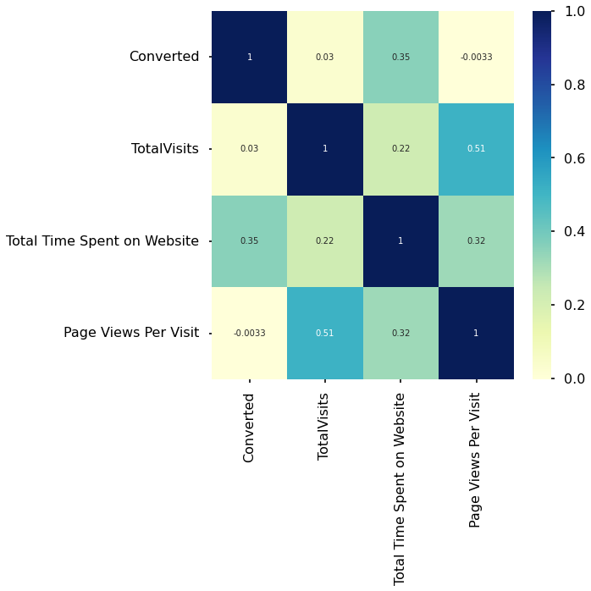
EDA Continues ….

Slide 7
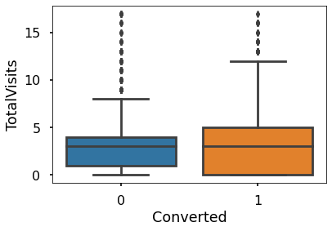
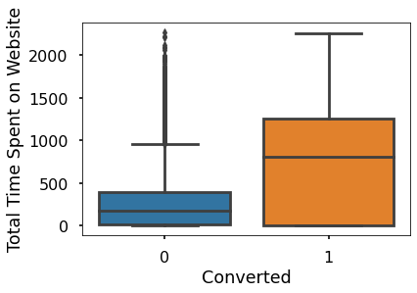
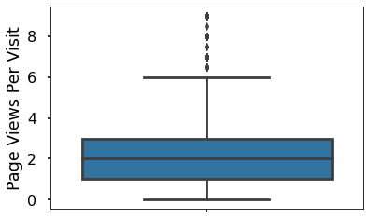
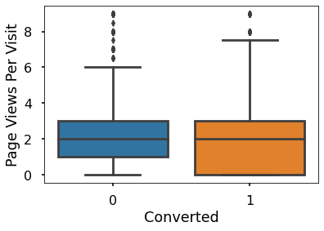
Numeric EDA Analysis

Slide 8
Data Conversion
Normalized the numeric values
Created Dummy value for categorical values
Total rows for analysis 8953
Total column for analysis 59

Slide 9
Model Creation
Split train and test dataset from the cleaned dataset
Tune the model using train dataset using RFE Feature selection from status module.
Drop the column has high P value and coefficient values
Test final model against train set and test set to analysis the precision of the model.

Slide 10
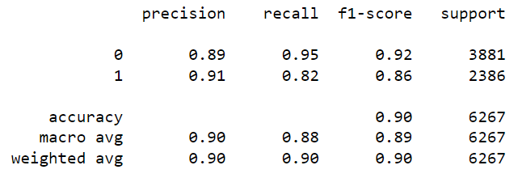
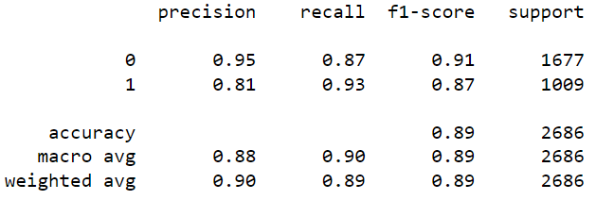
Model Results
After running the model on the Train Data these are the figures we obtain:
Accuracy : 90.00%
Sensitivity : 81.60%
Specificity : 95.33%
After running the model on the Test Data these are the figures we obtain:
Accuracy : 89.00%
Sensitivity : 92.96%
Specificity : 86.88%

Slide 11
Conclusion
We were able to achieve 90% accuracy average on both train and test set. With the use of this model, X Education will be able to better plan their company plans and develop by concentrating more on the elements that are most important to them.
It was discovered that the following factors, in descending order, were the most important to the potential buyers:
Welingak website
Google
Direct traffic
Organic search

Slide 12
Thank you
KRITHIKA CHANDRASEKARAN

